Slide 1
Jade agent programming framework introduction
Teacher : Dr farnaz derakhshan
Student : Mohsen akbari shahpar
Email : Mohsen-akbari@Outlook.com

Slide 2
What is Jade?
A middleware that facilitates the development of multi-agent systems
Including a runtime environment
Including a library
Including a graphical tool

Slide 3
How is structure of Jade?
Each running instance of the JADE runtime environment is called a Container
Every Container can contain several agents
The set of active containers is called Platform

Slide 4
How is structure of Jade?
A single container named Main container must always be active in the platform
Other Containers will register themselves with Main container

Slide 5
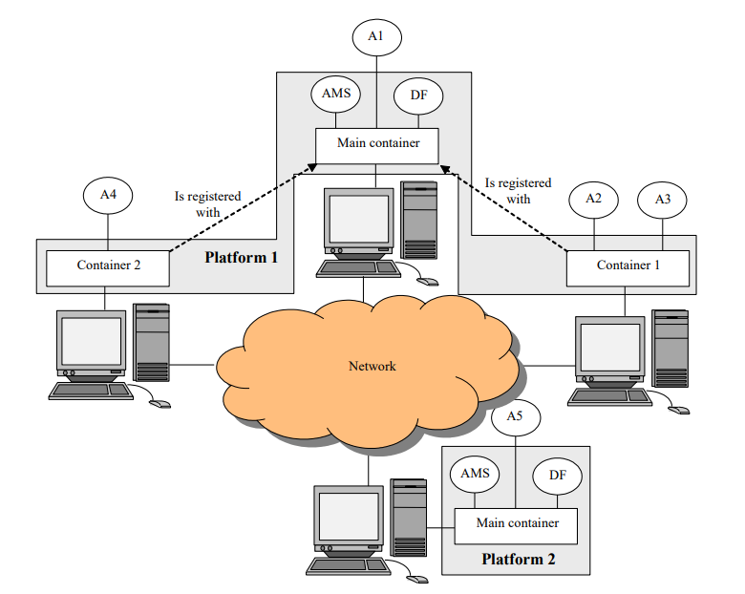

Slide 6
Example isn’t another way to teach, it is the only way to teach

Slide 7
What example we will elaborate?
The “BOOK TRADING” Example

Slide 8
The “BOOK TRADING” example
This scenario includes some agents selling books and others buying
Each buyer agent receives a book name to buy
The buyer agent broadcasts the book name to all seller agents
Each seller agent offers a price
The best offer will be accepted

Slide 9
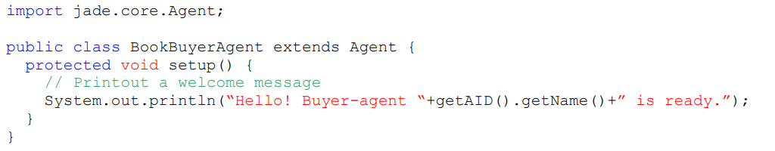
Creating an agent

Slide 10

Agent identifiers
Each agent is identified by an “agent identifier”
An agent identifier is represented as “<nickname>@<platform-name>”
So agent Peter living in platform P1 is called Peter@P1
The platform name is only used when agents in different platforms need to interact

Slide 11
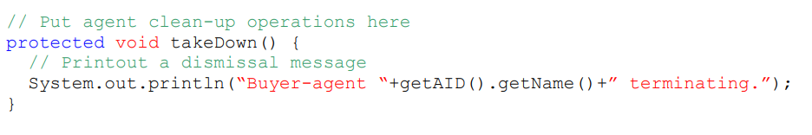
Terminating agents
Even if it does not have anything else to do after printing the welcome message, our agent is still running
In order to make it terminate its doDelete() method must be called
the takeDown() method is invoked just before an agent terminates
takedown() is intended to include agent clean-up operations

Slide 12
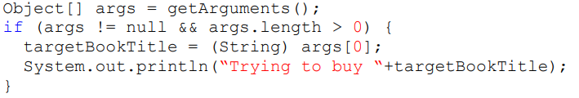
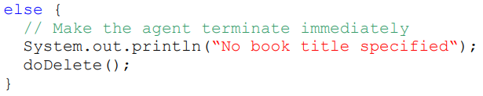
Passing arguments to an agent
Agents may get start-up arguments specified on the command line
These arguments can be retrieved, as an array of Object
Retrieving arguments is done by getArguments() method of the Agent class
As mentioned before we want our BookBuyerAgent to get the title of the book to buy as a command line argument

Slide 13
The Behaviours
The actual job an agent has to do is typically carried out within “Behaviours”
A behaviour represents a task that an agent can carry out
Each behaviour is implemented as an object of a class that extends jade.core.behaviours.Behaviour
The method addBehaviour() is used to execute behaviours by agent

Slide 14
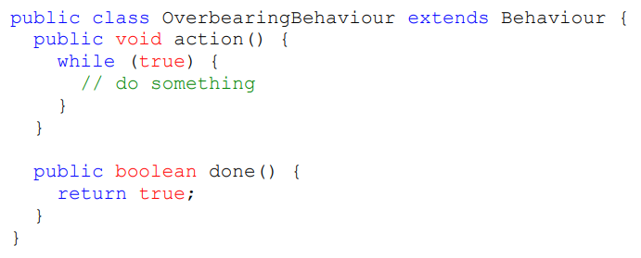
The Behaviours
Each class extending Behaviour implements action() and done() methods
The action() method implements real job the behaviour wants to do
The done() method specifies whether or not the behaviour job has completed

Slide 15
One-shot, cyclic and generic behaviours
“One-shot” behaviours that complete immediately and already implements the done() method by returning true
“Cyclic” behaviours that never complete and already implements the done() method by returning true
Generic behaviours that embeds a status and execute different operations depending on that status

Slide 16
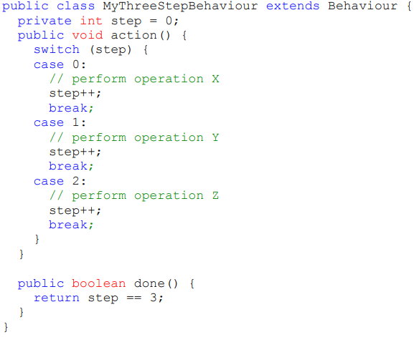

Slide 17
Scheduling operations
The WakerBehaviour
The TickerBehaviour

Slide 18
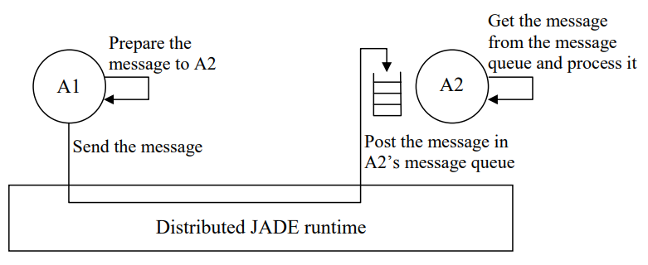
Agent communications

Slide 19
The ACL language
Messages exchanged by JADE agents have a format specified by the ACL language
The sender of the message
The list of receivers
The communicative intention (also called “performative”)
The content i.e. the actual information included in the message
The content language i.e. the syntax used to express the content
The ontology i.e. the vocabulary of the symbols used in the contents

Slide 20
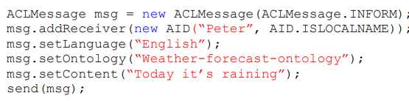
Sending messages
Sending a message to another agent is as simple as filling the fields of an ACLMessage object and then call the send()

Slide 21
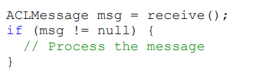
Receiving messages
An agent can pick up messages from its message queue by means of the receive() method

Slide 22
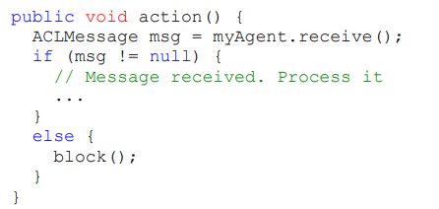
block() and blockingRecieve()

Slide 23
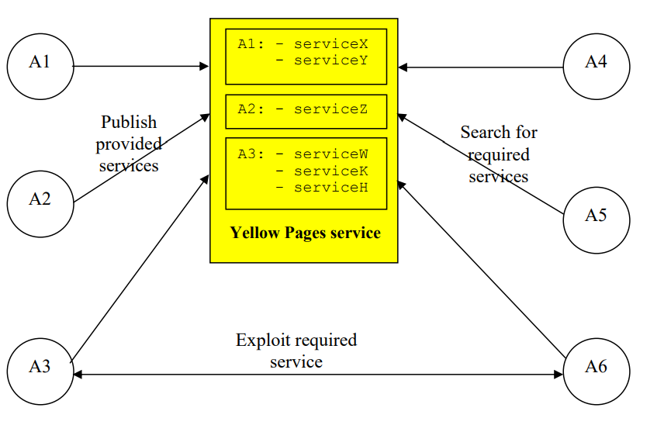
Yellow pages
This service allows agents to publish their services
This helps to other agents find agents with services they want

Slide 24
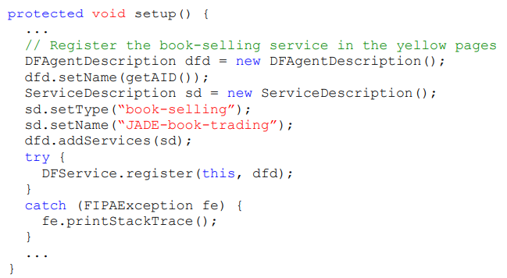
Publishing services

Slide 25
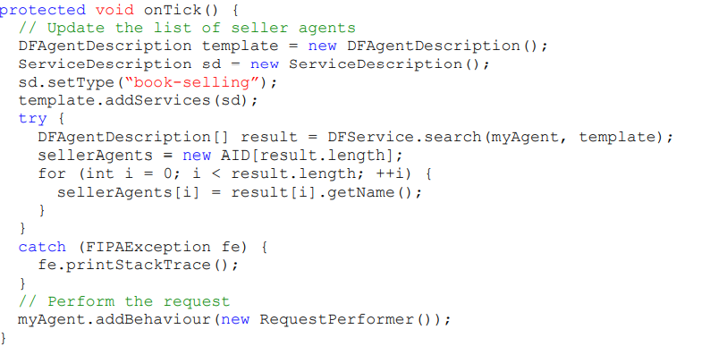
Searching services

Slide 26
?

Slide 27
Thank you

